Slide 1

Android framework

Slide 2
Topics
1. Android History
2. Android Architecture
3. Android Booting Processes
4. References

Slide 3
Android History
Android is an operating system developed by Google primarily for mobile devices such as smartphones and tablets. The history of Android begins in 2003 when a company called Android Inc. was founded by Andy Rubin, Rich Miner, Nick Sears, and Chris White.
The initial goal of Android Inc. was to develop an advanced operating system for digital cameras, but soon they realized the potential of their technology in the mobile industry.
In 2005, Google acquired Android Inc., and this marked a significant turning point in Android's history. Google saw the opportunity to create a powerful mobile platform and compete with other operating systems like iOS, Windows Mobile, and Symbian.
The first commercial version of Android, Android 1.0, was released on September 23, 2008. It was introduced on the HTC Dream, also known as the T-Mobile G1, which was the first Android-powered smartphone available to the public. Android 1.0 included basic functionalities such as a web browser, email support, Google Maps, and the Android Market (now known as Google Play Store).

Slide 4
Android Architecture
Android architecture contains a different number of components to support any Android device’s needs
Android software contains an open-source Linux kernel having a collection of a number of C/C++ libraries which are exposed through an application framework services
Android architecture is mainly divided into 5 layers.
1. Application Layer
2. API Framework
3. System Runtime Layer (Native C/C++ Libraries, Android Runtime)
4. Hardware Abstraction Layer
5. Linux Kernel

Slide 5
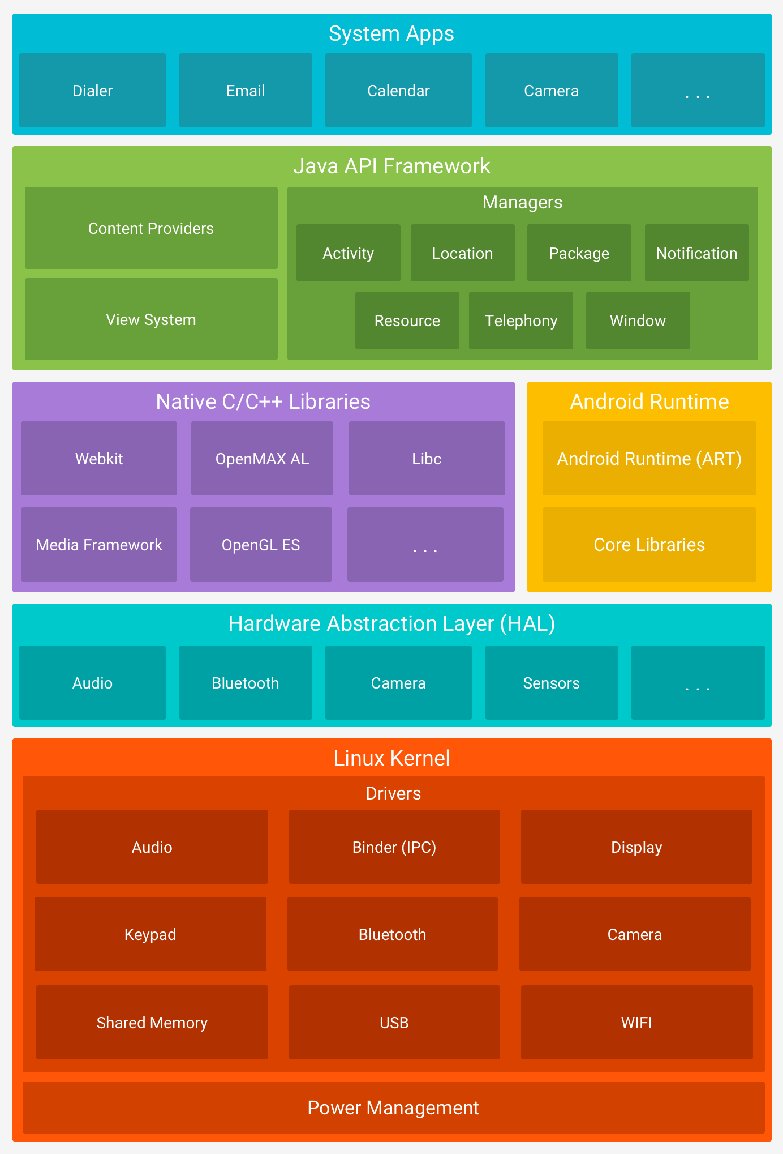

Slide 6
Application Layer: Applications is the top layer of Android architecture. it contains the system apps and the normal application
Responsible for direct interaction with users, usually developed in java or Kotlin
Application Framework: Application Framework or Java API framework, provides several important classes which are used to create Android applications.
This layer is written by java code and can be called java Framework
It includes different types of serval activity manager
Notification manager
View system
Package manager etc..

Slide 7
serval activity manager
Activity Manager | Manages the life cycle of each and every application and usually navigation fallback function
Location manager | Provides the geological location and positioning functioning services
Package manager | Manages all application installed in the android system
Notification manager | Allows the application to display custom prompt information in the status bar
Telephony Manager | Manages all mobile device functions
Windows Manager | Manages all open windows
Content Providers | Allows data to be shared between different applications
View System | Building the essential view component of the application

Slide 8
System Runtime Layer(Native)
1. C/C++ Library
2. Android Runtime Library
The C/C++ library can be used by different Android system components and provide developers with service through the application framework
OpenGL ES | 3D drawing function library
Libc | Standard C system function library inherited from BSD, specially customized for embedded Linux-based devices
Media Framework | Multimedia library support recording and playback of various commonly used audio and video formats
SQLite | The lightweight relational database engine
SGL | The underlying 2D graphics rendering engine
SSL | The secure socket layer is a security protocol that provides security and data integrity for network communication
Free Type | Portable font engine, it provides a unified interface to access a variety of font format fies

Slide 9
Android Runtime library
The runtime library is divided into the core library and the ART.
The core library provides most of the Java language core library functions so that developers can use the Java language to write Android application
The ART/Dalvik virtual machine is specifically customized for mobile devices, allowing multiple instances of the virtual machine to run in limited memory simultaneously, and each Dalvik application is executed as an independent Linux process
Hardware Abstraction Layer
The hardware abstraction layer is the interface between the operating system kernel and the hardware circuit.
Its purpose is to abstract the hardware. To protect the intellectual property rights of hardware manufacturers, it hides the hardware interface details of a specific platform and provides a virtual hardware platform.
Linux kernel layer
Android’s core system services and based on the Linux kernel, and some Android-specific drivers have been added on this basis.
The system’s security, memory management, process management, network protocol stack, and driver model depend on this kernel.

Slide 10
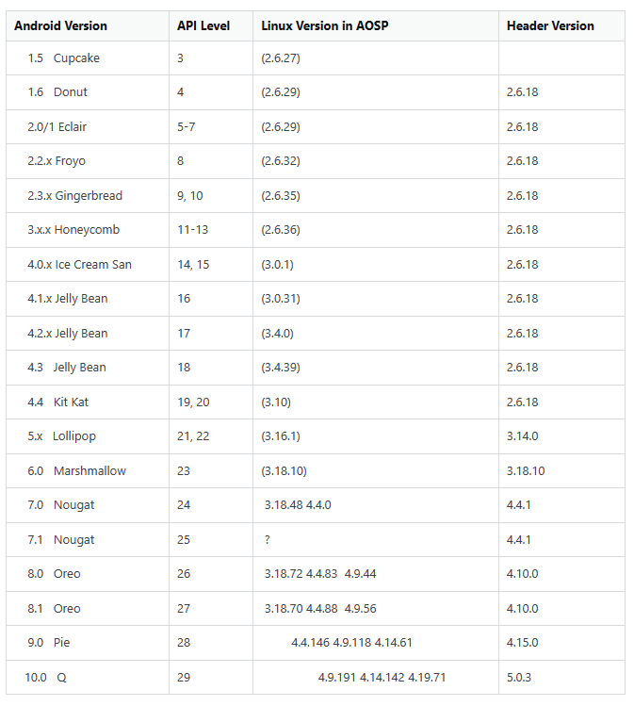
Kernel Versions for Android version

Slide 11
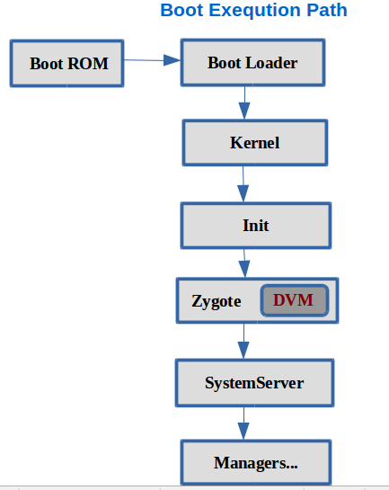
Android Booting Processes

Slide 12
Step 1: Power On and System Startup
When we press the power button, the Boot ROM code starts executing from a pre-defined location which is hardwired in ROM. It loads the Bootloader into RAM and starts executing.
Step 2: Bootloader
The bootloader is a small program that runs before Android does. This is NOT part of the Android operating system. The bootloader is the place where the manufacturer puts their locks and restrictions.
Step 3: Kernel
The Android kernel starts in a similar way as the linux kernel. As the kernel launches, is starts to setup cache, protected memory, scheduling and loads drivers. When the kernel finishes the system setup, it looks for “init” in the system files.
Step 4:Init Process
The Init process Mainly does four things
1. create the folders and mount the device
2. Set up SELinux Policies
3. Initialize and start the property service
4. Parse the Init.rc configuration file and start the zygote process

Slide 13
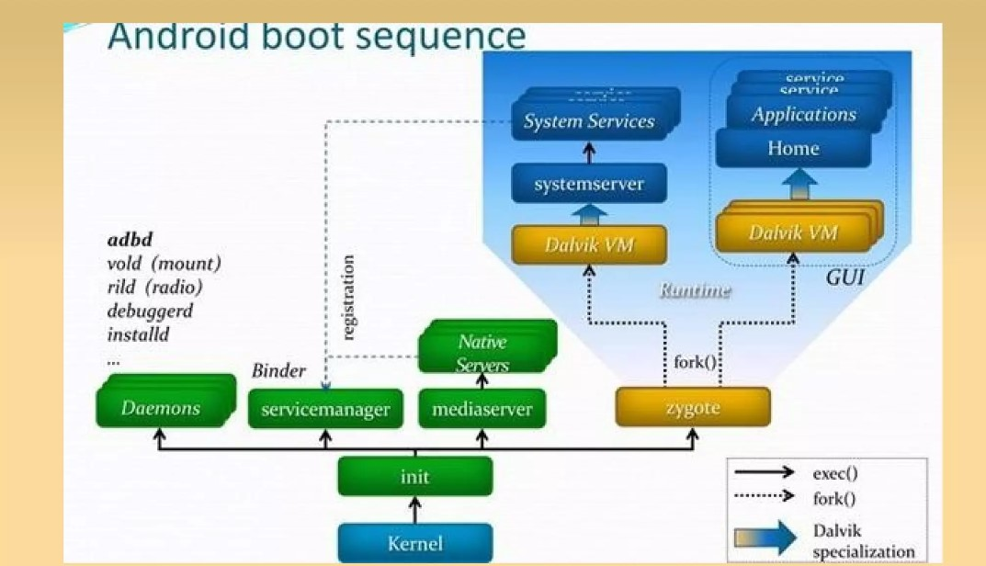
Zygote Process
In Android, the android runtime or the Dalvik virtual machine the application process, and the system server process that runs the key services of the system are all created by the zygote process

Slide 14
System server Process
After zygote preloads all necessary Java classes and resources, The Zygote forks a new process to launch the System Server.
The system server is the core of the Android system and it is started as soon as Dalvik is initialized and running.
Following is the Services started by SystemServer:- Core services:
Starting power manager Creating the Activity Manager Starting telephony registry Starting package manager Set activity manager service as the system process Starting context manager Starting system contact providers Starting battery service Starting alarm manager Starting sensor service Starting window manager Starting Bluetooth service Starting mount service

Slide 15
References
Which Android runs which Linux kernel? - Android Enthusiasts Stack Exchange
Android version history - Wikipedia
Android Architecture Explained in Detail - Bing video
Android Runtime - How Dalvik and ART work? - Bing video

Slide 16
Thank You

